Slide 1


Social Buzz
Data Analysis

Slide 2


Today's agenda
Project recap
Problem
The Analytics team
Process
Insights
Summary

Slide 3

Social Buzz is a social media and content creation company where content is at center stage
They keep users anonymous and track them through their reactions
They need external expertise to help them manage their highly complex data
Client’s Requirements
An audit of their big data practice
Recommendations for a successful IPO
An analysis of their content categories that highlights the top 5 categories with the largest aggregate popularity
Project Recap

Slide 4

Problem
Huge Data - Over 100000 per day and 36500000 of content everyday
As per client’s requirement – Top 5 Content Categories with high aggregate popularity

Slide 5



Andrew Fleming
Chief Technical Architect
The Analytics team
Marcus Rompton
Senior Principle
Kamna
Data Analyst

Slide 6
Process
1
Data Understanding
2
Data Cleaning
3
Data Modelling
4
Data Analysis
5
Data Visualization

Slide 7
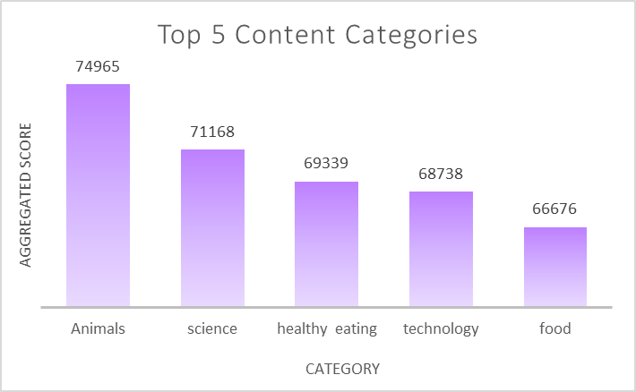

Insights

Slide 8
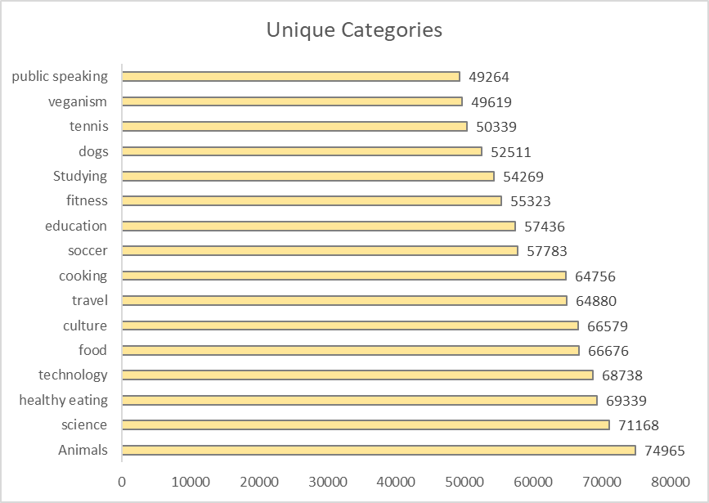

Slide 9
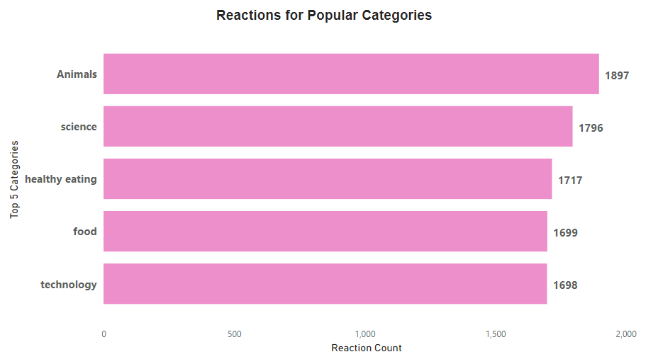

Slide 10
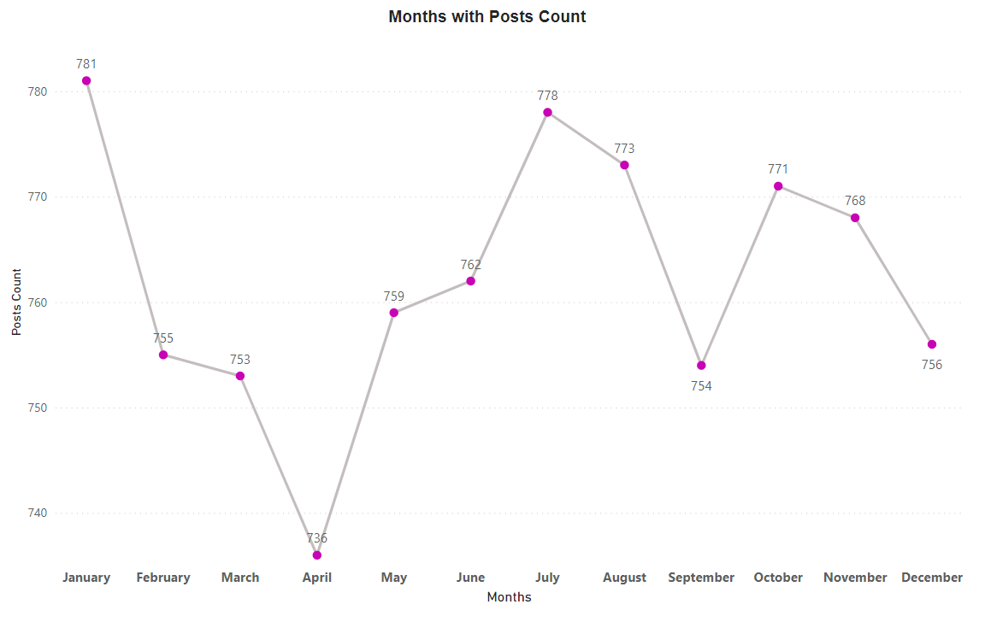

Slide 11

Most popular content categories -Animals & Science
Least popular - Public Speaking and Veganism
This means people like real-life and factual content the most
January Month has highest posts
Reaction on popular content category “Animal” has 1897 reactions
Summary

Slide 12
Thank you!
ANY QUESTIONS?

